Slide 1
Demo of the Skynet project
Team AT16

Slide 2

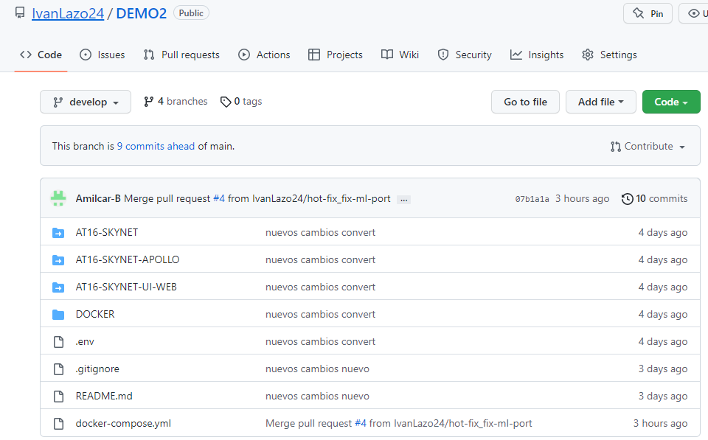
Tools
Python language
Pycharm
Postman
Swagger
Git
GitHub
Sourcetree
Docker
MongoDB
PostgreSQL
FFmpeg
Image Magick
Exiftools
Tesseract
PYQT
Apollo graphql
REACT

Slide 3
Microservices
Booking microservices
Booking
Person
Resource
Reporting microservices
Report Age Gender
Report Date Person Country
Report Model Type
Report Time Person Gender
Report State Person Gender
Converter Microservices
Audio converter
Video to image converter
Image converter
Wav to text converter
Image to text (OCR) converter
Translator converter
Metadata extractor
Machine learning microservices:
Object recognizer model VGG16
Object recognizer model Inception
Iris recognizer model
Face recognizer model
Emotion recognizer model
Apollo Server
Schema Graphql
Querys
Mutations

Slide 4
Booking service
Booking is a service for save resource data, person data and booking details.
The user can insert data that is then saved in the mongo database.

Slide 5

This service has 17 endpoints for the CRUD.
These endpoints are to create, update, delete, search and get all the information of the mongo data base.

Slide 6
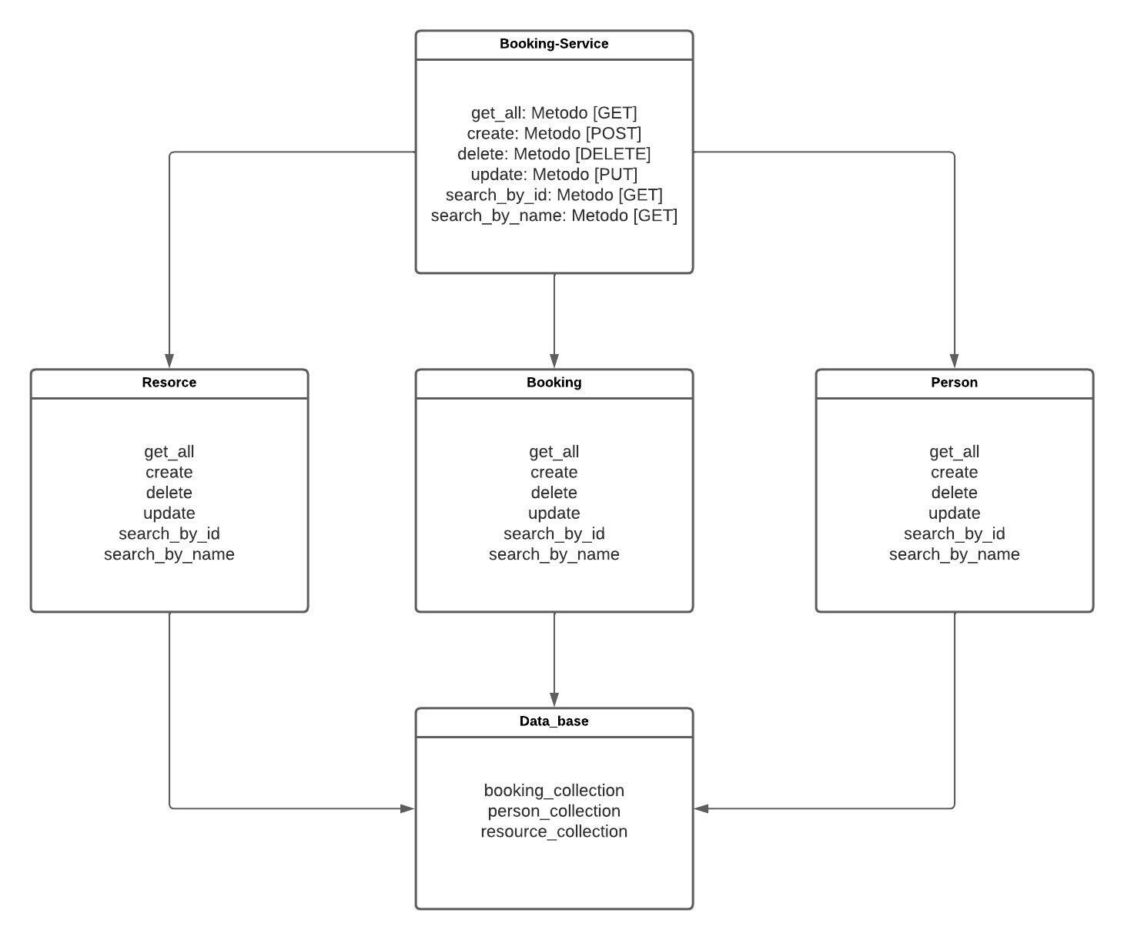
Class diagram

Slide 7
REPORTing service
Reporting service allow all users to interact with the data that is most important to them and the enterprise, conceive the true standing of their business and overall, it helps to make market decisions.

Slide 8
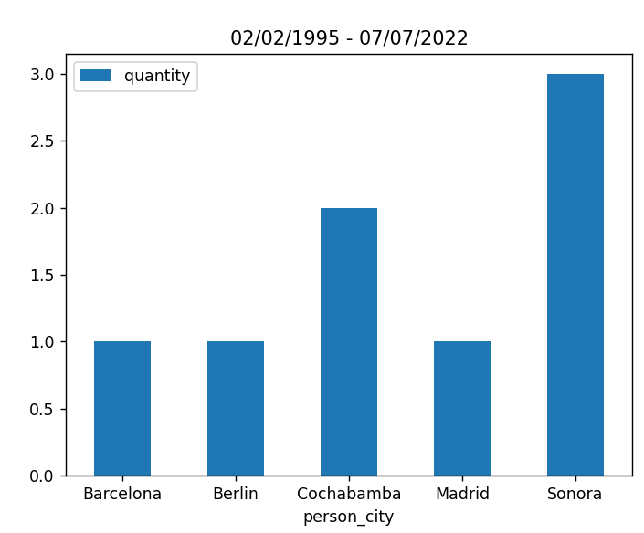
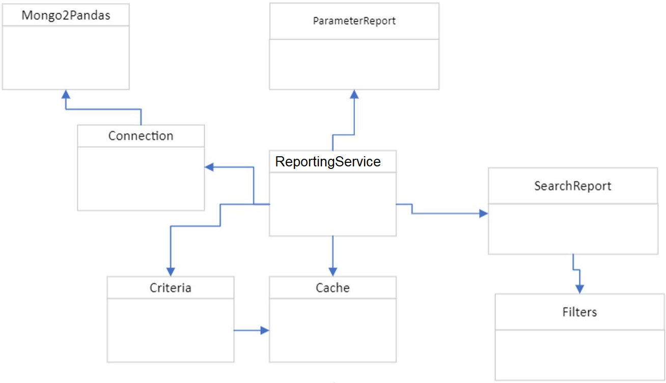
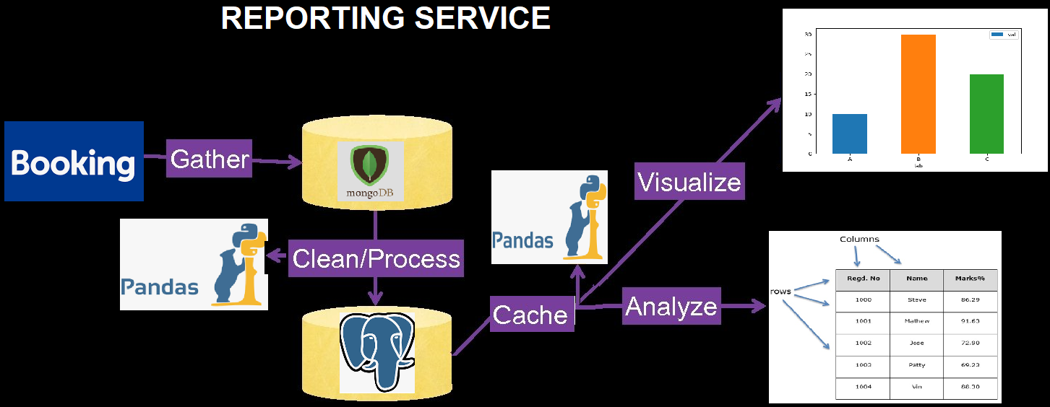
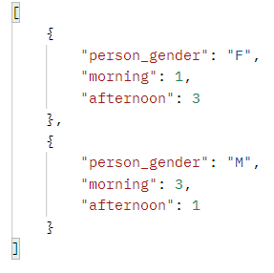
Class diagram
Notes:
The service have six end points with the method POST to obtain the required data.
The reporting service extract data from the booking database, processes/cleans the data with pandas, and inserts the data into PostgreSQL. Finally, the data is cached to be processed with pandas to parse or visualize the clean data.
The ports of end points are “6003” with the local host.

Slide 9
MACHINE LEARNING SERVICE
Machine learning service use trained machine learning models to search and recognize objects and persons in different images or videos

Slide 10
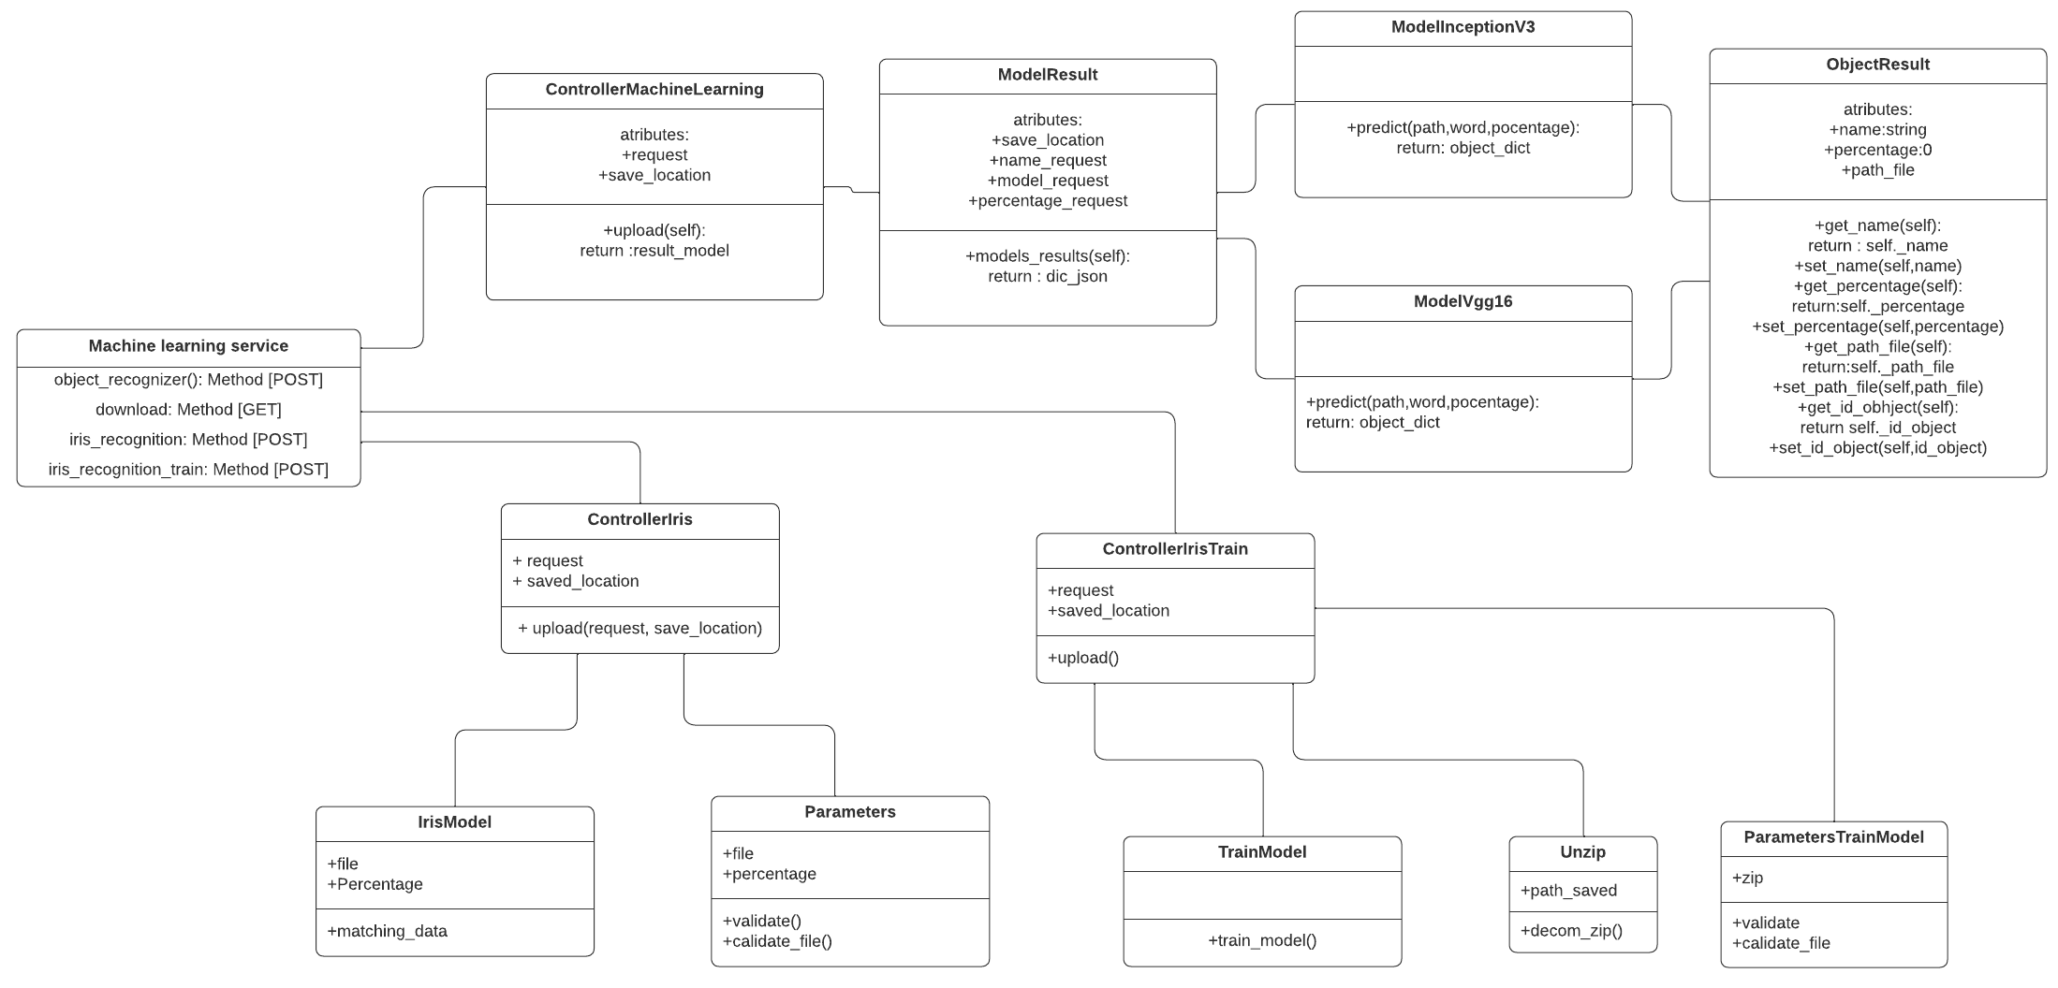
Class diagram

Slide 11


CONVERT SERVICE
The converter service of the project has its main function which is to be able to convert a great variety of files into other formats.
we have some models with which we can convert different formats such as audio, video, image, metadata, OCR. and others.

Slide 12
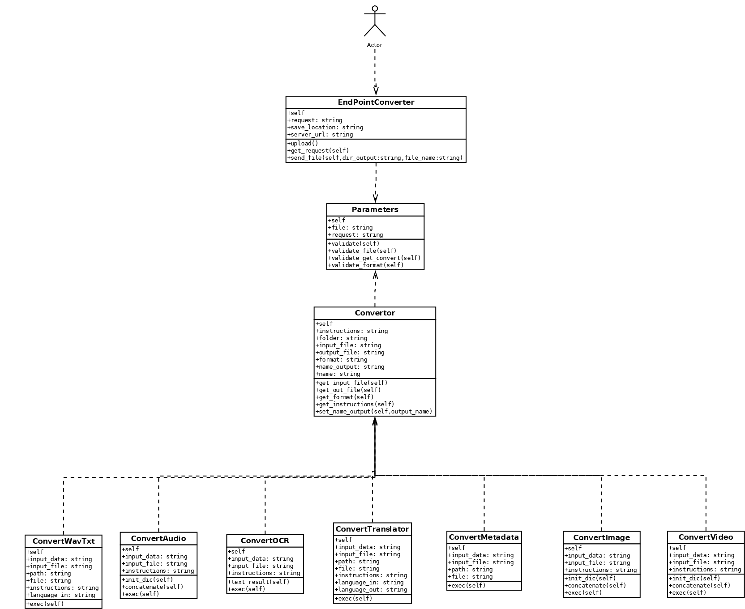
CLASS DIAGRAM

Slide 13
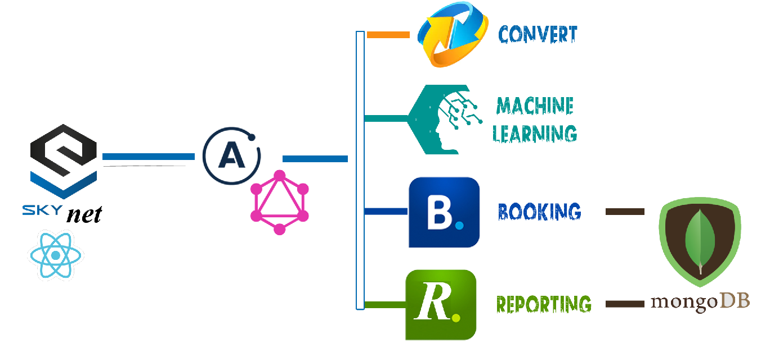
Architecture of the program in web
Ready
In process
Almost ready
Stay hold

Slide 14
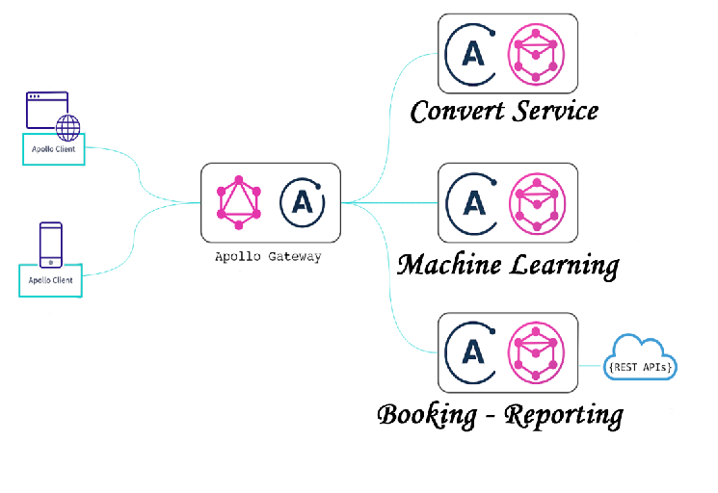
Apollo SERVER

Slide 15
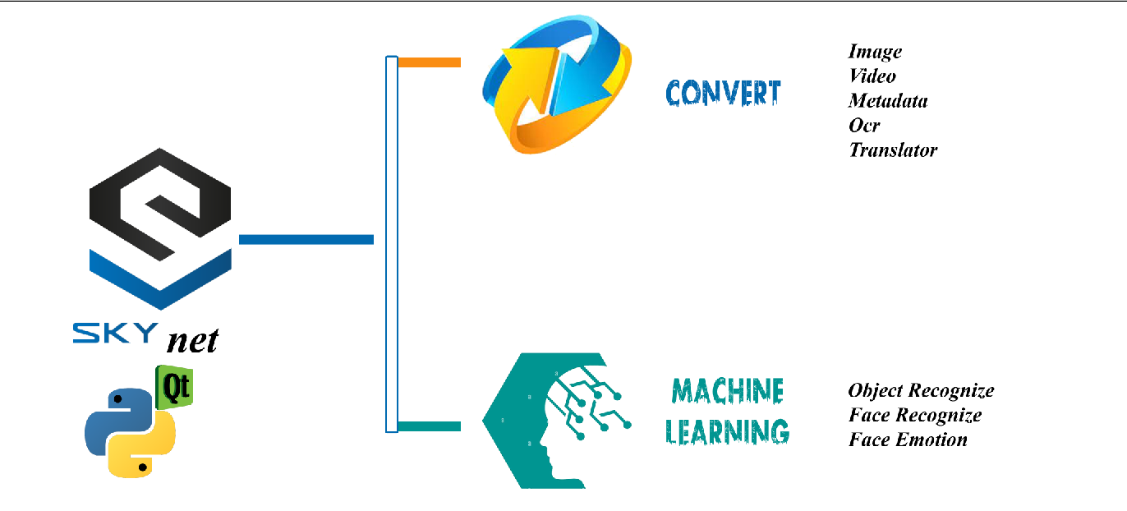

Slide 16
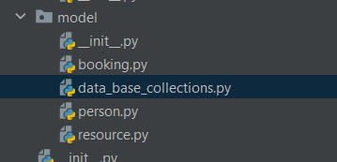
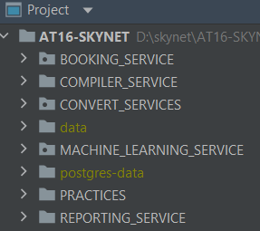
SOLID
For the “S” we created classes to have only one responsibility per class.
For the “O” the program should be Open to expand and Close for modify.

Slide 17
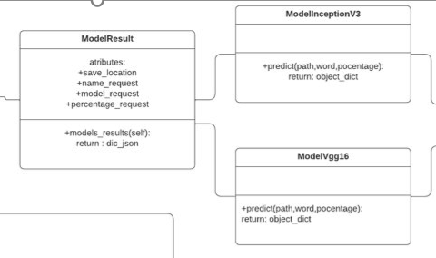
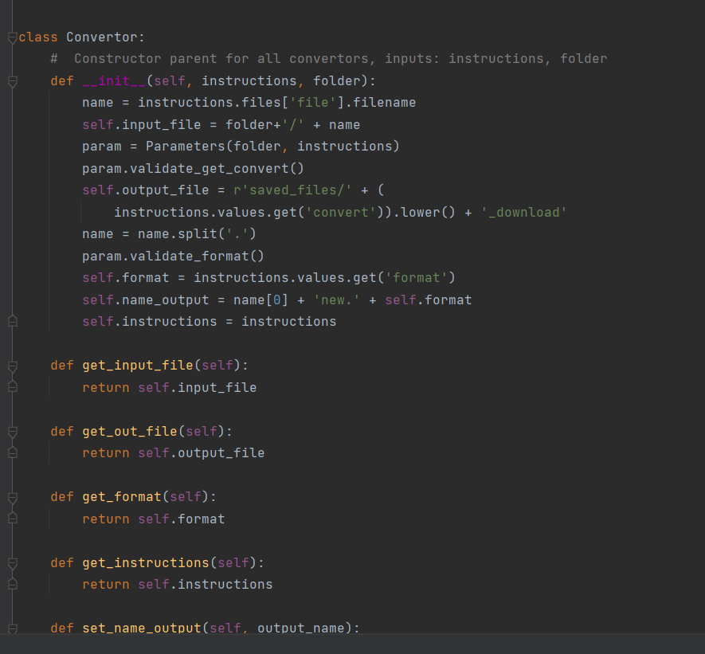
SOLID
For the “L”
The Liskov Substitution Principle (LSP) is one of five SOLID object-oriented design principles. It states that a superclass object should be replaceable with a subclass object without breaking the functionality of the software. It is a type of behavioral subtyping defined by semantic, rather than syntactic, design consideration.

Slide 18
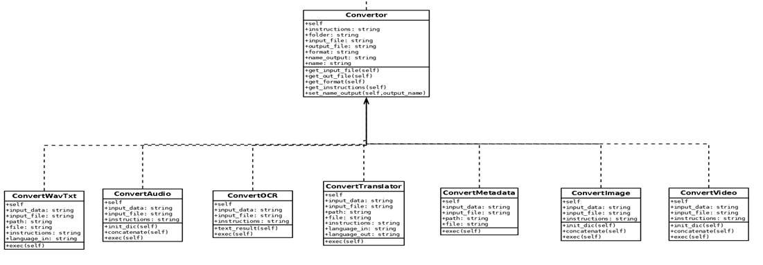
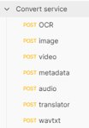
SOLID
For the I” we create different interfaces for different converters linked to a father class
For the “D” Entities must depend on abstractions, not on concretions. It states that the high-level module must not depend on the low-level module, but they should depend on abstractions. (This principle has not implemented in Skynet yet)

Slide 19
The services are running in docker
Linux system operating, alpine 3.10
Python 3
Requirements.txt

Slide 20
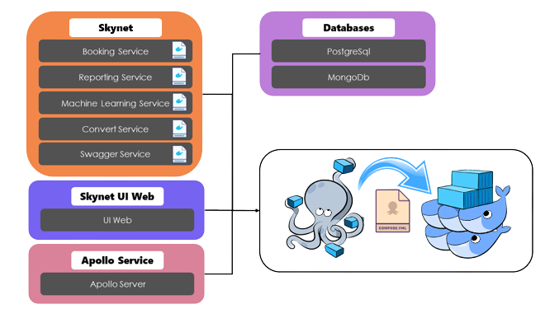
Skynet Docker Flow

Slide 21
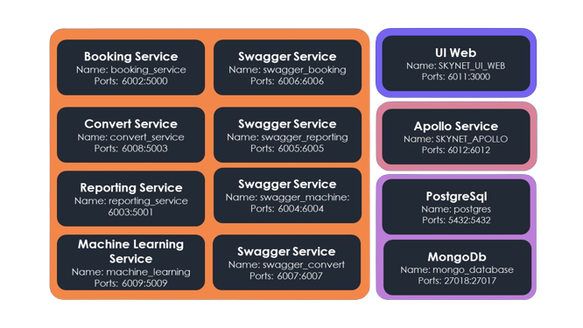

Container details

Slide 22
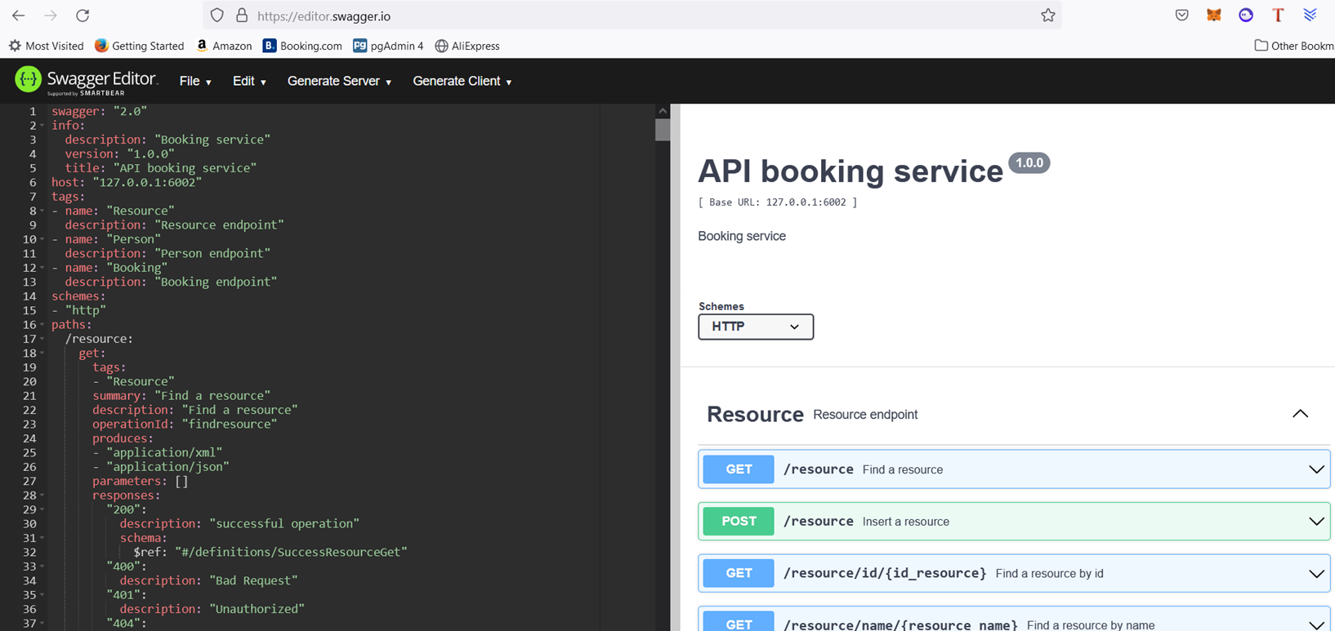
SWAGGER

Slide 23
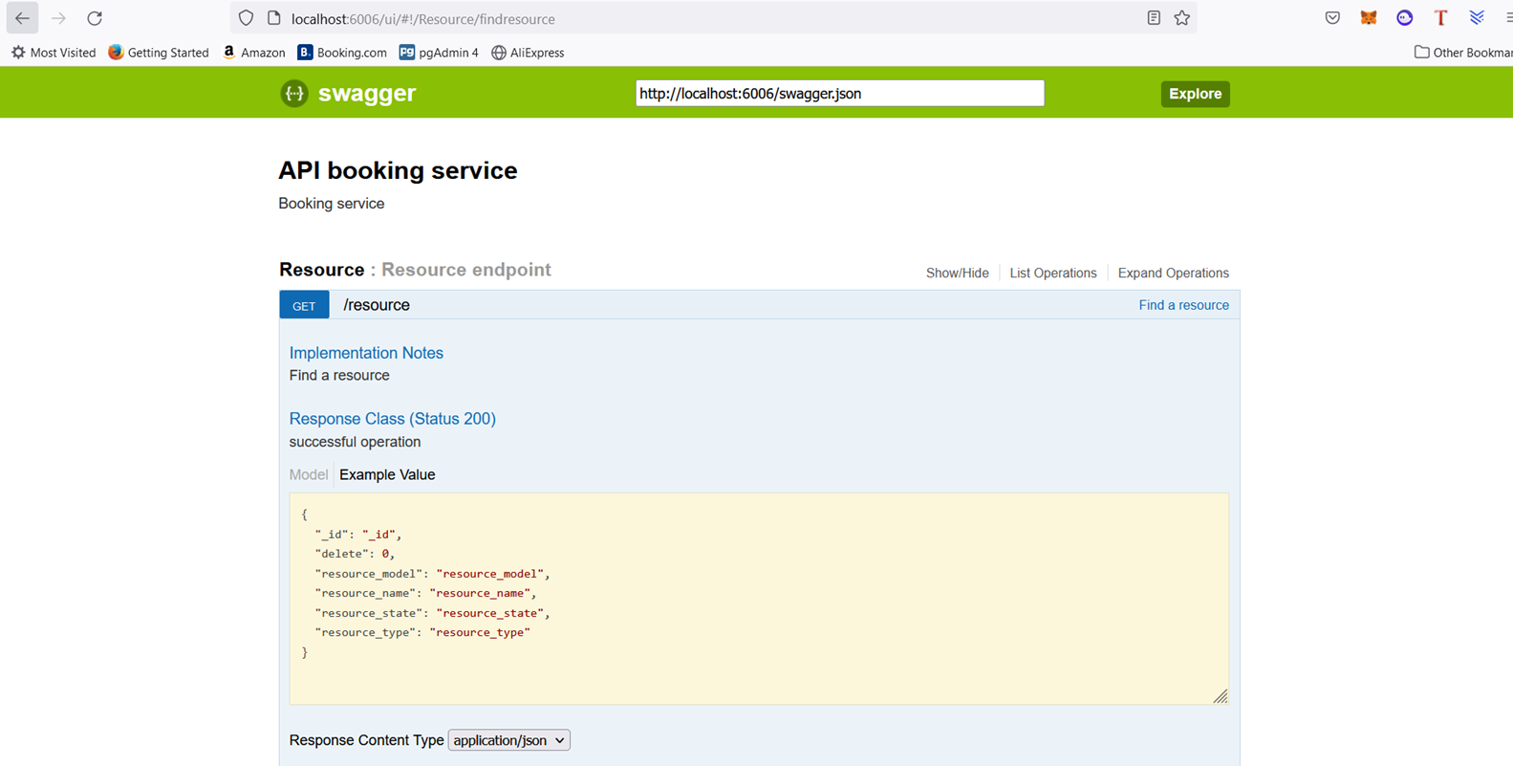
SWAGGER

Slide 24

PyQT
PyQT is a tool for designing graphical user interfaces.
This tool was used to create the UI in desktop, it provides several UI components called widgets, such as layouts, buttons, combobox, text area, tables, being the most used in the views.
PyQt comes with a simple and easy to use API functionality.

Slide 25
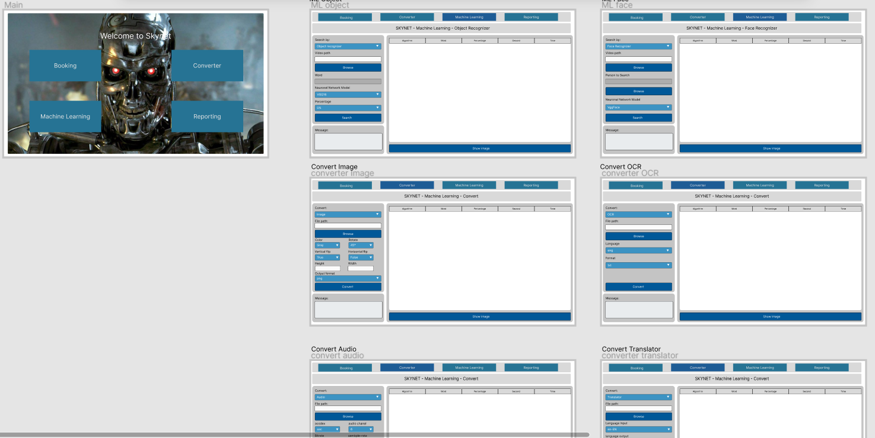
PyQT
Initially it was designed mockups using Figma to create the views that the application will have.
After understanding the Widget components to be used and proceeded to replicate the views.

Slide 26
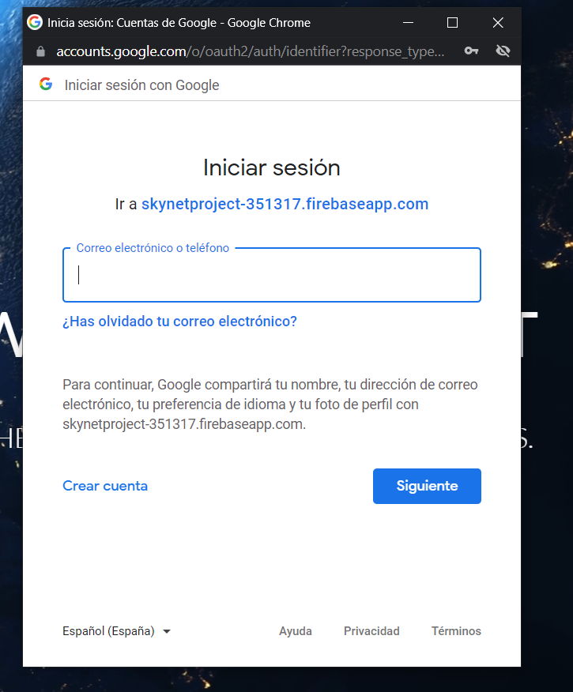
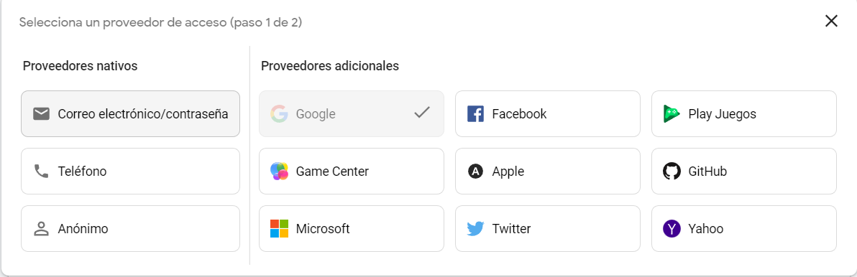
Login in web UI
Firebase
Google authentication
ApiKey

Slide 27
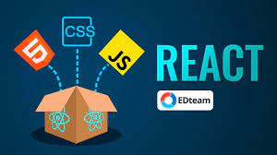
React
React helps you create interactive user interfaces in a simple way. Design simple views for each state in your app, and React will take care of efficiently updating and rendering the correct components when the data changes.

Slide 28
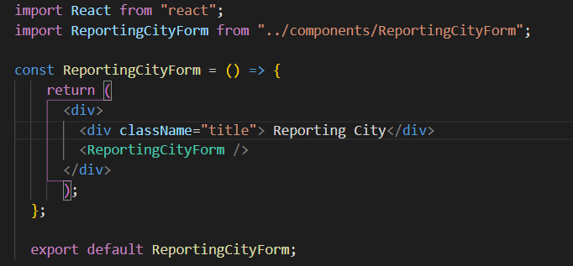
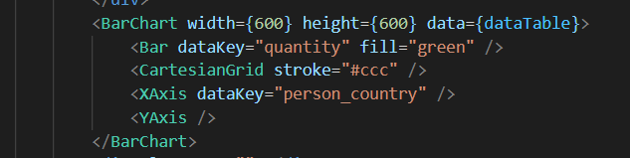
React

Slide 29

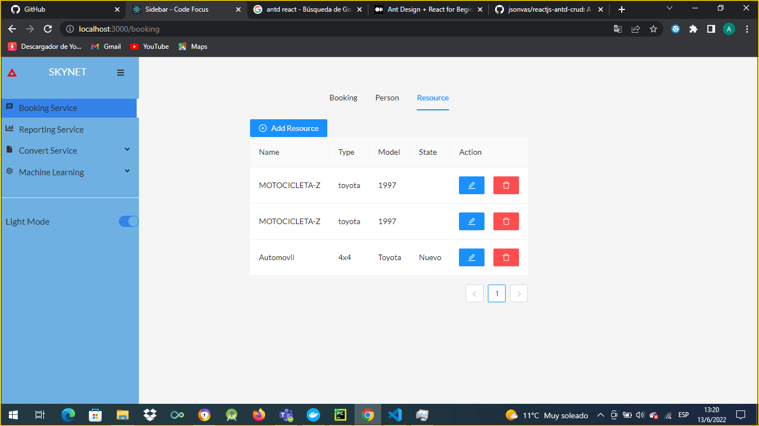
Antd -react

Slide 30
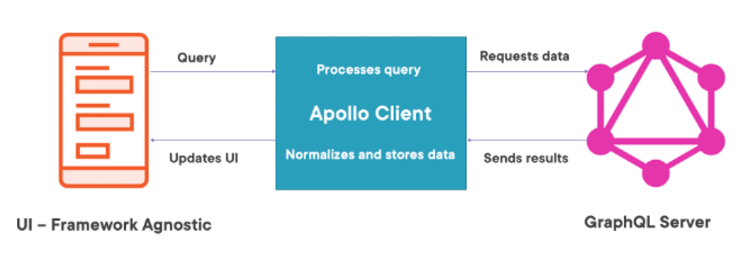
GRAPHQL - APOLLO CLIENT
Apollo Client
Apollo Provider
Gql
Use Query
Use Mutation
React
Apollo Server

Slide 31
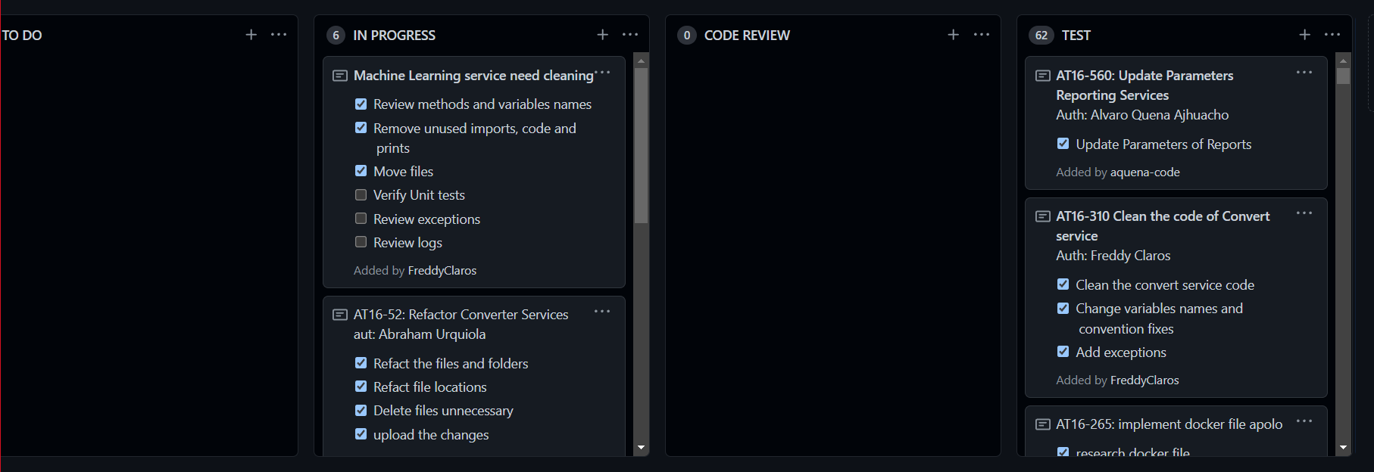
Backlog tasks
To Do | In Progress | Code Review | Test | Total Tickets
0 | 6 | 0 | 62 | 68

Slide 32
Known issues
Convert service
Image convert flip not working
Convert does not accept files with spaces in the names
Audio not work if there's not voice in the first seconds
OCR does not recognize some images with figures
Machine learning service
Object recognizer model Resnet deprecated
Machine learning docker Jupyter not used
Emotion recognizer sometimes mistake the emotions
Skynet web
Convert service in web needs double click to convert files

Slide 33
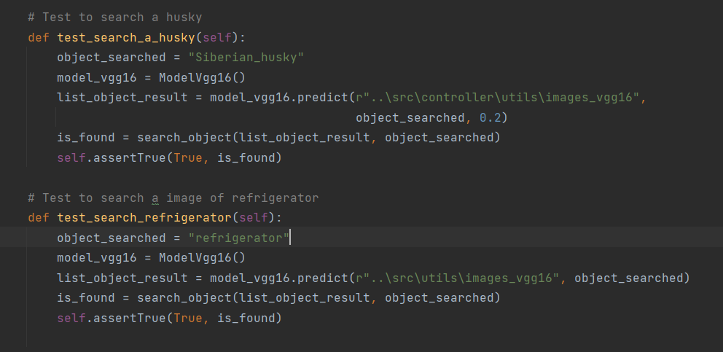
Metrics
Unit tests

Slide 34
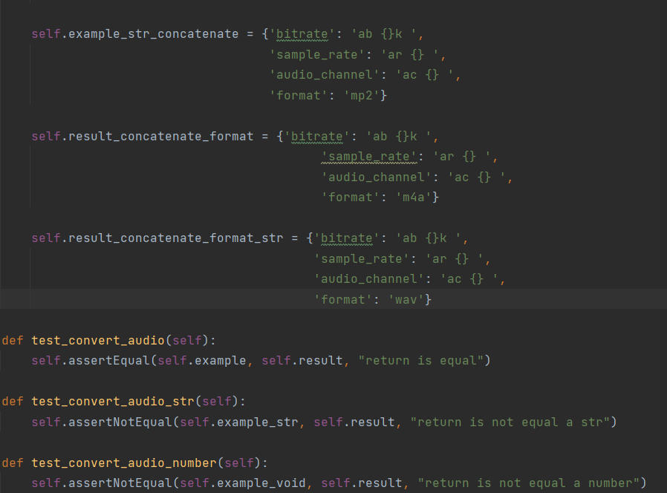
Metrics
Unit tests

Slide 35
Coverage
• Function coverage: how many of the functions defined have been called.
• Statement coverage: how many of the statements in the program have been executed.

Slide 36
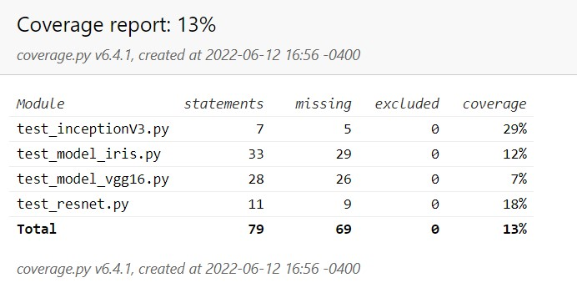
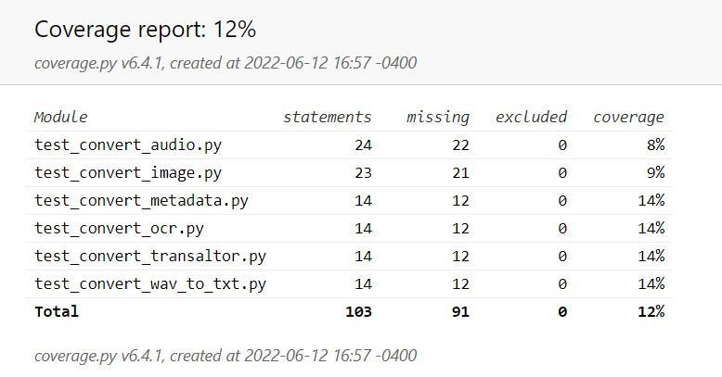
Coverage
Machine learning service
Convert service

Slide 37



DEMO

Slide 38

Any question?
We will be happy to answer them now.

Slide 39


